Slide 1
Multi level and multiple INHERITANCE

Slide 2
Multilevel Inheritance
In this type of inheritance, a derived class is created from another derived class.

Slide 3
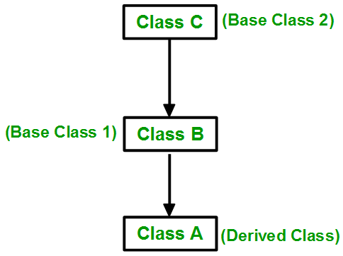

Slide 4
Multiple Inheritance
Multiple Inheritance is a feature of C++ where a class can inherit from more than one classes. i.e one sub class is inherited from more than one base classes.
The derived class are allowed to use the joint features of the inherited base classes.

Slide 5
class subclass_name : access_mode base_class1, access_mode base_class2, ....
{
//body of subclass
};

Slide 6
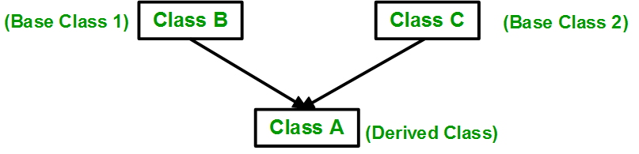
Multiple Inheritance

Slide 7
1. | Single inheritance is one in which the derived class inherits the single base class. | Whereas multiple inheritance is one in which the derived class acquires two or more base classes.
2. | In single inheritance, the derived class uses the features of the single base class. | While in multiple inheritance, the derived class uses the joint features of the inherited base classes.
3. | Single inheritance requires small run time as compared to multiple inheritance due to less overhead. | While multiple inheritance requires more run time time as compared to single inheritance due to more overhead.
4. | Single inheritance is a lot of close to specialization. | In contrast, multiple inheritance is a lot of close to generalization.
5. | Single inheritance is implemented as Class DerivedClass_name : access_specifier Base_Class{};. | While multiple inheritance is implemented as Class DerivedClass_name : access_specifier Base_Class1, access_specifier Base_Class2, ….{}; .
6. | Single inheritance is simple in comparison to the multiple inheritance. | While multiple inheritance is complex in comparison to the single inheritance.
7. | Single inheritance can be implemented in any programming language. | C++ supports multiple inheritance but multiple inheritance can’t be implemented in any programming language(C#, Java doesn’t support multiple inheritance).

Slide 8
Hierarchical Inheritance
In this type of inheritance, more than one sub class is inherited from a single base class. i.e. more than one derived class is created from a single base class.

Slide 9
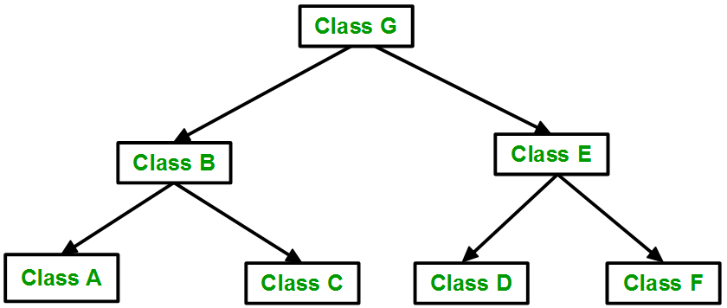

Slide 10
Hybrid Inheritance
Hybrid Inheritance is implemented by combining more than one type of inheritance. For example: Combining Hierarchical inheritance and Multiple Inheritance.

Slide 11
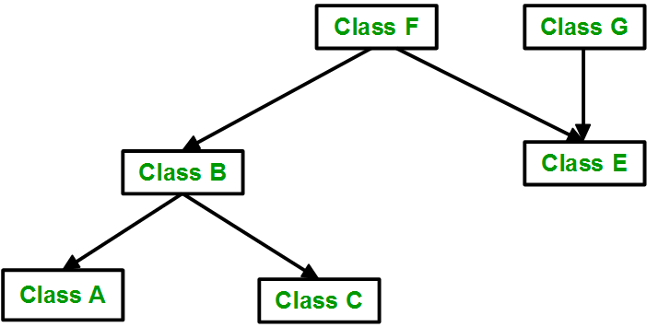

Slide 12
Multiple Inheritance
We’ll finish our current topic by demonstrating multi-inheritance. We need to emphasize that using this technique is commonly recognized as error-prone and obfuscating class hierarchy.
Any solution that avoids multi-inheritance is generally better and in fact many contemporary object programming languages don’t offer multi-inheritance at all. We think it’s a good argument to consider when you’re making design assumptions.

Slide 13

Multiple Inheritance (contd…)
class A
{
public:
A() { cout << "A's constructor called" << endl; }
};
class B
{
public:
B() { cout << "B's constructor called" << endl; }
};
class C: public B, public A // Note the order
{
public:
C() { cout << "C's constructor called" << endl; }
};
int main()
{
C c;
return 0;
}
Output

Slide 14
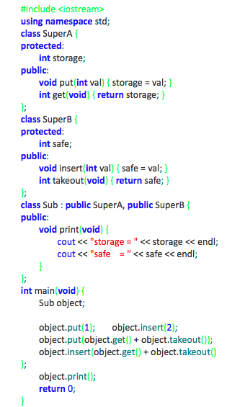
Multiple Inheritance - Ambiguity
This example should be clear (we hope).
The program will produce the following output:
storage = 3
safe = 5

Slide 15

Multiple Inheritance - Ambiguity
class SuperA
{
protected:
int storage;
public:
void put(int val){ storage = val; }
int get(){ return storage; }
};
class SuperB
{
protected:
int safe;
public:
void put(int val){ safe = val; }
int get(){ return safe; }
};
class Sub: public SuperB, public SuperA
{
public:
void print()
{
cout<<"Storage: "<<storage<<endl;
cout<<"Safe: "<<safe<<endl;
}
};
int main()
{
Sub s;
s.put(5); //Ambiguous call
//(call to SubA-put or SubB-put?)
cout<<s.get(); //Similar issue here
return 0;
}
Output: 5

Slide 16
Multiple Inheritance – Diamond Problem
The diamond problem occurs when two superclasses of a class have a common base class.
For example, in the following diagram, the TA class gets two copies of all attributes of Person class, this causes ambiguities

Slide 17

Multiple Inheritance – Diamond Problem
class Person {
// Data members of person
public:
Person(int x) { cout << "Person::Person(int ) called" << endl; }
};
class Faculty : public Person {
// data members of Faculty
public:
Faculty(int x):Person(x) {
cout<<"Faculty::Faculty(int ) called"<< endl;
}
};
class Student : public Person {
// data members of Student
public:
Student(int x):Person(x) {
cout<<"Student::Student(int ) called"<< endl;
}
};
class TA : public Faculty, public Student {
public:
TA(int x):Student(x), Faculty(x) {
cout<<"TA::TA(int ) called"<< endl;
}
};
int main() {
TA ta1(30);
}
Output

Slide 18


Diamond Problem – The Solution
class Person {
public:
Person(int x) { cout << "Person::Person(int ) called" << endl; }
Person() { cout << "Person::Person() called" << endl; }
};
class Faculty : virtual public Person {
public:
Faculty(int x):Person(x) {
cout<<"Faculty::Faculty(int ) called"<< endl;
}
};
class Student : virtual public Person {
public:
Student(int x):Person(x) {
cout<<"Student::Student(int ) called"<< endl;
}
};
class TA : public Faculty, public Student {
public:
TA(int x):Student(x), Faculty(x) {
cout<<"TA::TA(int ) called"<< endl;
}
};
int main() {
TA ta1(30);
}
Output

